Slide 1
Assignment 1:
Noise,
Normalisation and
Custom Keras Layers
Team 10:
Rama Krishna
Rohith Nagabhyrava
Umair Akhtar

Slide 2
Keras Layers
Keras Layers are the basic building block of neural networks.
Call them little functions which are stateful
Have associated weights with them that can be trainable or non-trainable
We basically change these weights in a layer while fitting model
All keras layers have a number of common methods like:
layer.get_weights()
layer.set_weights()
layer.get_config()
Input,input_at,output,output_at,shape,etc...

Slide 3
Writing your Own Keras Layer

Slide 4
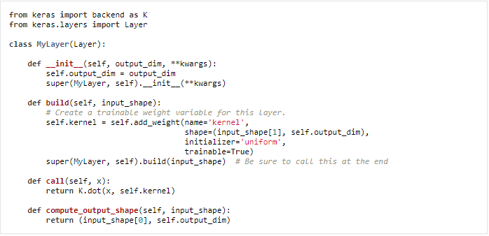
Custom Keras Layers

Slide 5
Three methods to implement
build(input_shape)
call(x)
compute_output_shape()
Define your weights
This method must also set self.build to True at the very end.
Layer’s main logic
Unless you want your layer to support masking, we only got to care about the first argument passed.
Output shape
Incase the layer modifies the shape of its input, a specification for the shape transformation logic is required here

Slide 6
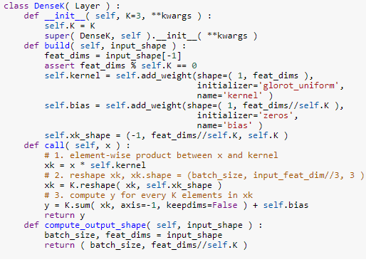
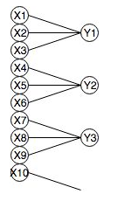
DenseK Solution over base code

Slide 7
Normalization Layer

Slide 8


General Normalization
Normalization or Feature Scaling is a method used to standardize the range of features of data.
Generally performed during the data preprocessing step.
Why do we need to perform normalization?
Min-Max Normalization
Mean Normalization
https://en.wikipedia.org/wiki/Normalization_(statistics)
Notes:
Before getting to normalization layer. lets see what regular normalization is.
If we did not normalize our data we may have some numerical data points in our dataset that might be very high and others very low. The larger data points in these non normalized data sets can cause instability in model.

Slide 9
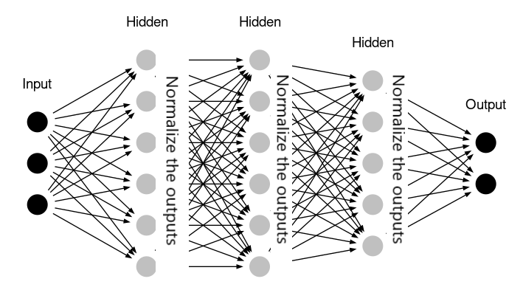
Batch Normalization
Batch Norm is the normalization of the output in each hidden layer.
https://medium.com/@ilango100/batch-normalization-speed-up-neural-network-training-245e39a62f85

Slide 10
Why Batch Normalization?
During training, each layer is trying to correct itself for the error made up during the forward propagation. But every single layer acts separately, trying to correct itself for the error made up.
Due to changes in weights of previous layers, the distribution of input values for current layer changes, forcing it to learn from new “input distribution”.
Normalization to the input of neural networks fastens up training but every layer changes this distribution so the consecutive layers are not benefited. So we use batch normalization.

Slide 11
Batch Normalization
Batch Normalization adds Normalization “layer” between layers.
Normalization has to be done separately for each dimension, over the ‘mini-batches’ hence the name Batch Normalization.
Normalization brings all the inputs centered around 0. This way, there is not much change in each layer input.
So, layers in the network can learn from the back-propagation simultaneously, without waiting for the previous layer to learn. This fastens up the training of networks.

Slide 12
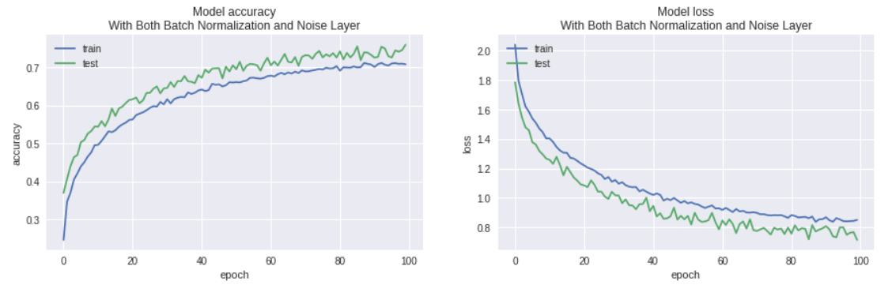
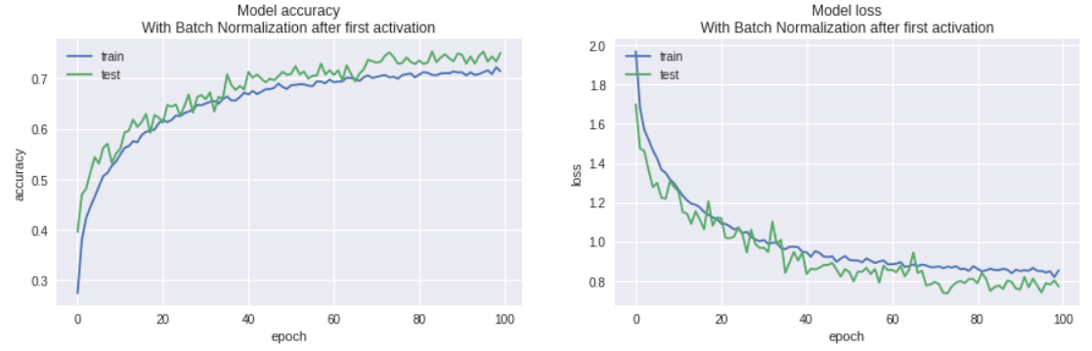
Results
Base Model With Normalization Layer
Faster learning
Higher overall accuracy (In this case).

Slide 13
ADDING NOISE TO NEURAL NETWORK

Slide 14
PROBLEM
Training a neural network with a small dataset can cause the network to memorize all training examples, in turn leading to poor performance on a holdout dataset.
Small datasets may also represent a harder mapping problem for neural networks to learn, given the patchy or sparse sampling of points in the high-dimensional input space.

Slide 15
SOLUTION
Adding noise during training can make the training process more robust and reduce generalization error.
Noise is traditionally added to the inputs, but can also be added to weights, gradients, and even activation functions.
Adding noise to the training dataset works more efficient when the inputs were normalised.

Slide 16
WORKING
Adding noise expands the size of the training dataset. Each time a training sample is exposed to the model, random noise is added to the input variables making them different every time it is exposed to the model. In this way, adding noise to input samples is a simple form of data augmentation.
The noise means that it is as though new samples are being drawn from the domain in the vicinity of known samples, smoothing the structure of the input space.
This may result in decrease of accuracy as the noise added to the inputs makes it hard for the model to predict but it makes the model more robust.

Slide 17
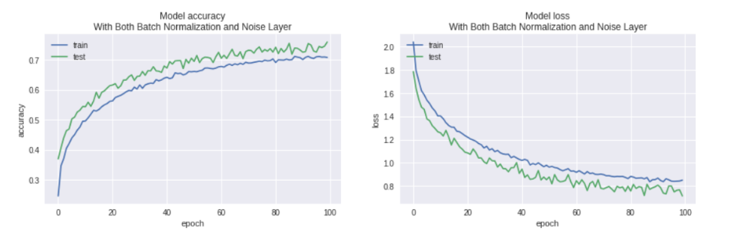
RESULTS
MODEL ACCURACY WHEN NO NOISE WAS ADDED TO TRAINING DATA

Slide 18
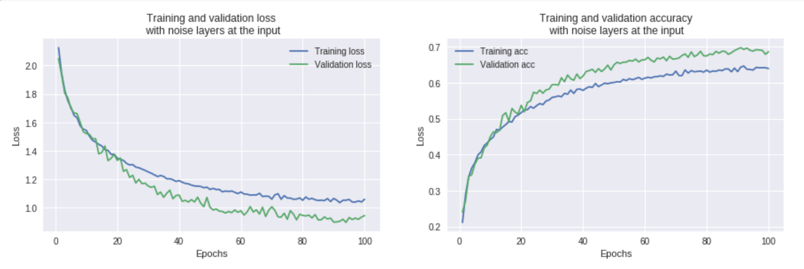
RESULTS
MODEL ACCURACY WHEN NOISE IS ADDED TO THE TRAINING DATA

